Slide 1
Research on Github
Interested are:
Deepa Paneru
Kamala Mishra
Lilawati Rana
Niruta Chaudhary
Purnima Pant
Suma Tharu

Slide 2
Table of contents:
Introduction
Sample codes
Reasons
Remaining research
Conclusion
Questionare

Slide 3

Introduction to Github:
GitHub is a proprietary developer platform that allows developers to create, store, manage, and share their code. It uses Git(a distributed version control system (DVCS) that tracks changes in files within a project over time.) to provide distributed version control and GitHub itself provides access control, bug tracking, software feature requests, task management, continuous integration, and wikis for every project.

Slide 4
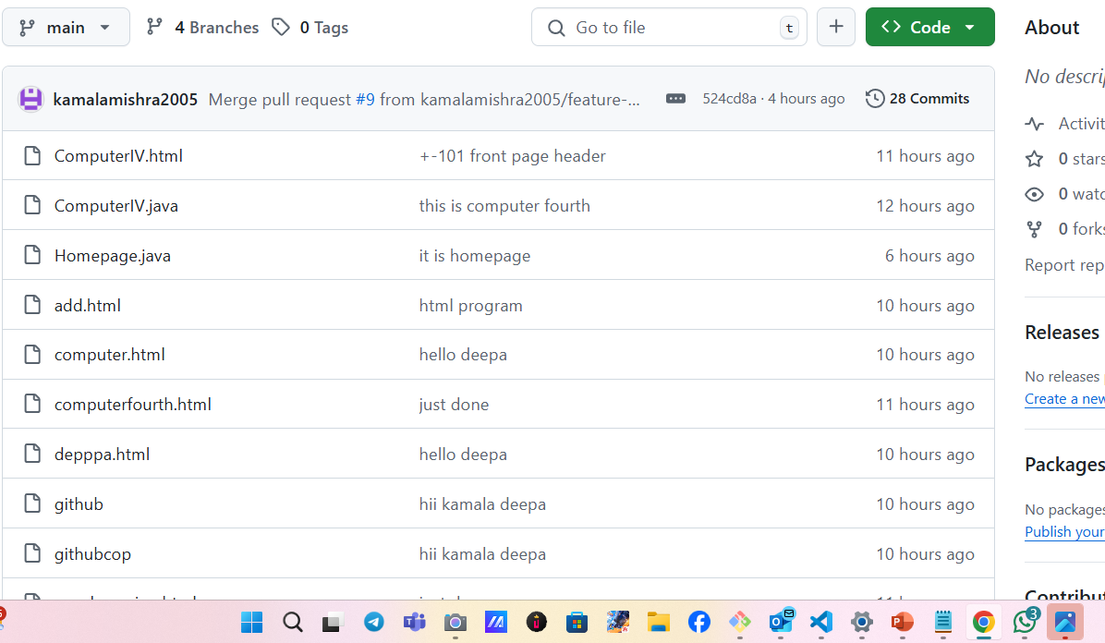
Code added to github:

Slide 5
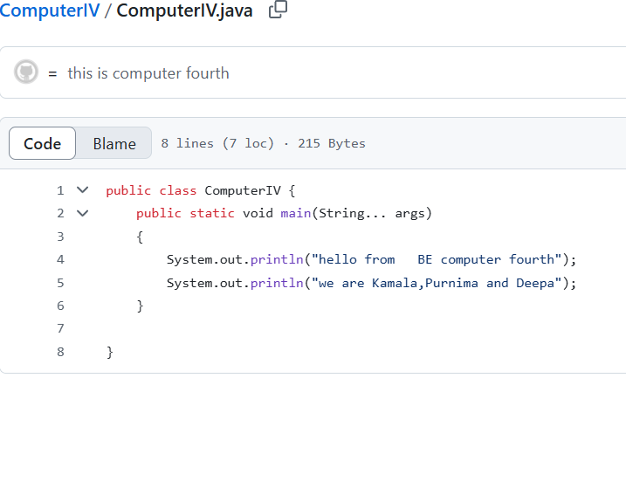
Sample of a code:

Slide 6
Reasons behind to want to research on github
(research that are already happen)
1.Storing and Sharing Research Materials:
GitHub allows researchers to store and share data, code, protocols, and other research materials in a centralized, remote location.
2. Facilitating Collaboration:
Researchers can collaborate on projects by working together on the same repository, allowing for easier sharing and version control.
3.Promoting Reproducibility:
By making data, code, and protocols publicly available, researchers can increase the transparency and reproducibility of their work.

Slide 7
Continue…
4.Managing Projects and Tasks:
GitHub can be used to manage research projects and tasks, including identifying, assigning, and categorizing tasks.
5.Open Access and Open Source:
GitHub can be used to share research materials openly, promoting open access and open source research practices.
6.Centralized Storage and Sharing:
GitHub provides a centralized location for storing and sharing research materials, making them easily accessible to collaborators and the wider research community.

Slide 8
Remaining research on github:
Collaboration & Social Coding:
e.g. code quality, reviewer responsiveness, project size, examines biases, bottlenecks, and effectiveness of peer reviews, core-periphery model in open-source projects).
2. Open-Source Development:
What makes some projects thrive while others fail (e.g., documentation, community engagement),High workload and stress among OSS maintainers.
3.Software Engineering & Productivity
Machine learning models predict defects based on commit history,GitFlow, trunk-based development
The role of automation (e.g., Dependabot, CI bots) in modern workflows.

Slide 9
Continue…
4. Privacy & Data Ownership:
Balancing research with user privacy concerns,Risks for developers in censored environments.
5. The Future of Remote Collaboration:
How GitHub enables remote-first teams after COVID,Could virtual workspaces replace pull requests?

Slide 10
Conclusion:
GitHub serves as a living laboratory software engineering, offering unparalleled access to code, collaboration, and developer behavior. Research on GitHub bridges theory and practice, informs tool development, and helps shape future trends in technology. However, ethical guidelines and respect for open-source licenses are essential when leveraging its data.

Slide 11
Questionare:
Have you any question???

